Slide 1
Root Finding 2: Newton’s Method
AMSC/CMSC 460
Dr. Christopher Moakler

Slide 2
Summary of Last Class
Last class we discussed the bisection method and the fixed-point iteration method.
The bisection method was sure to converge but only linearly.
The FPI method is locally convergent if the slope at the fixed point is less than one.
It is also only linearly convergent.
Any root finding problem can be rewritten as a fixed point problem.
Neither of these methods should be your first choice for finding a root of an equation.
Much better methods exist.
Such as…

Slide 3
Newton’s Method
Newton did not actually use the method we will be discussing today.
It is sometimes called the Newton-Raphson method.
Raphson also did not give the method in the form we use today.
It seems the method in the form we’ll discuss today was first given by Thomas Simpson, of Simpson’s Rule fame.
Simpson did not come up with Simpson’s Rule either…

Slide 4
Newton’s Method Outline
Newton’s Method takes an initial guess,$x_{0}$, of a root.
A tangent line of the function at this point is drawn.
Where that tangent line intersects the x-axis becomes our next guess for the root, $x_{1}$.
Another tangent is drawn and the crossing with the x-axis is found.
This again becomes our new guess.
The process is iterated over.

Slide 5
Newton’s Method Graphically
https://commons.wikimedia.org/wiki/File:NewtonIteration_Ani.gif

Slide 6
Let’s add a little math
With the initial guess of, $x_{0}$, we can get the slope of the function at that point, $f′(x_{0})$.
Now we need a way to calculate the y-intercept.
The point-slope equation of a line tells us
$y−f′(x_{0})$ = $f′(x_{0})$($x−x_{0})$.
An x-intercept means $y=0$.
So,
$0−f(x_{0})$ = $f′(x_{0})$($x−x_{0})$
$x−x_{0}=−\frac{f\left(x_{0}\right)}{f^{′}\left(x_{0}\right)}$
$x=x_{0}−\frac{f\left(x_{0}\right)}{f^{′}\left(x_{0}\right)}$.

Slide 7
Newton’s Method Algorithm
$x_{0}=rand$ %Initial guess
for i = 1:nstepmax
$x_{i+1}=x_{i}−\frac{f(x_{i})}{f′(x_{i})}$
end

Slide 8
Newton’s Method Example
Ex. $x^{3}+x −1=0$
We need the derivative
$f^{′}\left(x\right)=3x^{2}+1$
The update equation is thus
$x_{i+1}=x_{i}−\frac{x_{i}^{3}+x_{i}−1}{3x_{i}^{2}+1}$
Let’s start with an initial guess $x_{0}=−0.7$
$x_{1}=x_{0}−\frac{x_{0}^{3}+x_{0}−1}{3x_{0}^{2}+1}=(−0.7)−\frac{{(−0.7\text{)}}_{}^{3}+(−0.7\text{)}−1}{3{(−0.7\text{)}}^{2}+1}$
$x_{1}≈0.1271$

Slide 9
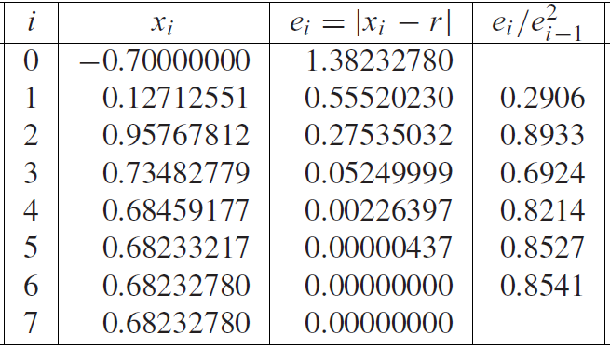
Newton’s Method Example Contd
The next few iterations are on the right.
After only 6 steps we have an answer correct up to 8 decimal places.
The square of the error at one step is proportional to the square of the error at the previous step.
This is called quadratic convergence.
Sauer

Slide 10
Rates of Convergence
The Bisection method and FPI were both linearly convergent.
The convergence is considered linear if
$\lim_{i→∞}{\frac{e_{i+1}}{e_{i}}}=S<1.$
This convergence is linear with rate S.
Newton’s Method is quadratically convergent.
The convergence is considered quadratic if
$\lim_{i→∞}{\frac{e_{i+1}}{e_{i}^{2}}}=M<∞.$
Quadratic convergence means we have a doubling of the correct decimal places at every iteration.

Slide 11
Quadratic Convergence of Newton’s Method
If $f(x)$ is twice continuously differentiable, $f\left(x_{r}\right)=0$, and $f^{′}\left(x_{r}\right)≠0,$ then Newton’s method is locally quadratically convergent to $x_{r}$.
$\lim_{i→∞}{\frac{e_{i+1}}{e_{i}^{2}}}=\frac{f^{′′}(x)}{2f^{′}(x)}=M$
Proving this is relatively straightforward and you should convince yourself of this fact.
At every iteration the error is given by
$e_{i+1}≈Me_{i}^{2}=\left|\frac{f^{′′}(x)}{2f^{′}(x)}\right|e_{i}^{2}$

Slide 12
Comparing the different methods
The error at each step for the bisection method is,
$e_{i+1}=Se_{i}=\frac{1}{2}e_{i}$
The error at each step for FPI is,
$e_{i+1}≈Se_{i}= \left|g′(x_{r})\right|e_{i}$
The error at each step for Newton’s Method is,
$e_{i+1}≈Me_{i}^{2}=\left|\frac{f^{′′}(x)}{2f^{′}(x)}\right|e_{i}^{2}$
For Newton’s Method, once the error goes below 1, the convergence is very rapid and relatively independent of M.

Slide 13
Linear Convergence of Newton’s Method
Newton’s Method is not ALWAYS quadratically convergent.
Ex. $f\left(x\right)= x^{2}$
What is Newton’s Method in this example?
$x_{i+1}= x_{i}−\frac{f\left(x_{i}\right)}{f^{′}\left(x_{i}\right)}$
$x_{i+1}= x_{i}−\frac{x_{i}^{2}}{{2x}_{i}}$
$x_{i+1}= \frac{x_{i}}{2}$
We simply divide by two at every iteration.

Slide 14
Linear Convergence of Newton’s Method Contd
What is the error formula for this example?
With $e_{i}=\left|x_{i}−x_{r}\right|$ our error formula is simply,
$e_{i+1}=\frac{1}{2}e_{i}$
This is just liner convergence.
This slower convergence holds whenever we apply Newton’s Method to a function of the form $f\left(x\right)= x^{m}$.
The error formula for functions of this form is easy enough to get,
$e_{i+1}=\frac{m−1}{m}e_{i}$
Why does Newton’s Method have such poor performance in these examples?

Slide 15
Multiplicity of Roots
The previous example exhibited a multiple root.
At a multiple root, $f^{′}\left(x_{r}\right)=0.$
We needed that first derivative to be nonzero to prove the quadratic convergence.
Higher order roots have higher order derivatives that are nonzero.
A root of order m has,
$\frac{d^{m−1}}{dx^{m−1}}f\left(x_{r}\right)=0$
The error formula for linear convergence in Newton’s method holds if the function is a $(m+1)$ times differentiable function with a root of multiplicity $m$.

Slide 16
The Modified Newton’s Method
We can modify Newton’s Method to perform better when there are multiple roots of a function.
We can even restore the full quadratic convergence!
If $f(x)$ is $(m+1)$ time differentiable function with a root of multiplicity $m>1$, the Modified Newton’s Method is
$x_{i+1}=x_{i}−m\frac{f(x_{i})}{f^{′}(x_{i})}$
If we can recognize that a function has a multiple root, we can switch to using the Modified Newton’s Method and still retain the quadratic convergence.

Slide 17
Modified Newton’s Method Example
Let’s look at an example.
$f\left(x\right)=\sin\left(x\right)+x^{2}\cos\left(x\right)−x^{2}−x$
It is easy to see that this function has a root at $x=0$.
What is the multiplicity of that root?
$f\left(x\right)=\sin\left(x\right)+x^{2}\cos\left(x\right)−x^{2}−x$
$f^{′}\left(x\right)=\cos\left(x\right)+2x\cos\left(x\right)+x^{2}\sin\left(x\right)−2x−1$
$f^{′′}\left(x\right)=−sin\left(x\right)+2\cos\left(x\right)−4xsin\left(x\right)−x^{2}\cos\left(x\right)−2$
$f^{′′′}\left(x\right)=−cos\left(x\right)−6\sin\left(x\right)−6xcos\left(x\right)−x^{2}\sin\left(x\right)$
The first two derivatives are 0 at the root while the third is not.
Thus, this is a triple root.

Slide 18
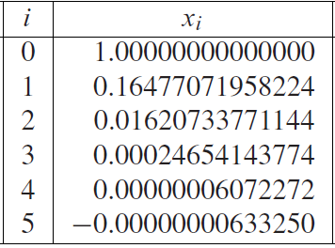
Modified Newton’s Method Example Contd
$x_{i+1}=x_{i}−m\frac{f\left(x_{i}\right)}{f^{′}\left(x_{i}\right)}$
$x_{i+1}=x_{i}−3\frac{\sin\left(x_{i}\right)+{x_{i}}^{2}\cos\left(x_{i}\right)−{x_{i}}^{2}−x_{i}}{\cos\left(x_{i}\right)+2x_{i}\cos\left(x_{i}\right)+{x_{i}}^{2}\sin\left(x_{i}\right)−2x_{i}−1 }$
After 5 iterations we have a correct estimate up to 8 decimal places.
We will not get better than this.
Why does this not go all the way to $ε_{machine}$?
Sauer

Slide 19
Types of Error
It is very rare to get an algorithm to find an answer within machine epsilon of the analytic answer.
This is caused by the two types of error
Forward error
Backward error
For root finding, the backward error in our approximation of the root. $x_{approx}$, is $\left|f\left(x_{approx}\right)\right|$.
The forward error is $\left|x_{r}−x_{approx}\right|$
Why do they have these names?

Slide 20
Forward and Backward Error
The types of error are named in this way because of how we approach the problem at hand.
We wish to solve an equation by finding a value we can plug into a function so it returns 0.
The problem has an input which we perform actions on to yield an output.
The input is the function itself and the output is the approximate root of that function.
Actions
Input
Output

Slide 21
Forward and Backward Error Contd
Solving Method
Function
Solution
Error can occur on the input or on the output.
The error on the left is the “backward” error and is the amount we need to change the function to make our answer correct.
The error on the right is the “forward” error and is the amount we need to change our solution to make our answer correct.
Backward error : $\left|f\left(x_{approx}\right)\right|$
Forward error : $\left|x_{r}−x_{approx}\right|$
So, what’s limiting us here?

Slide 22
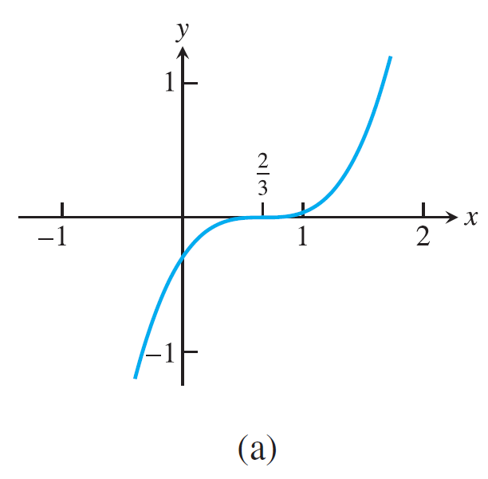
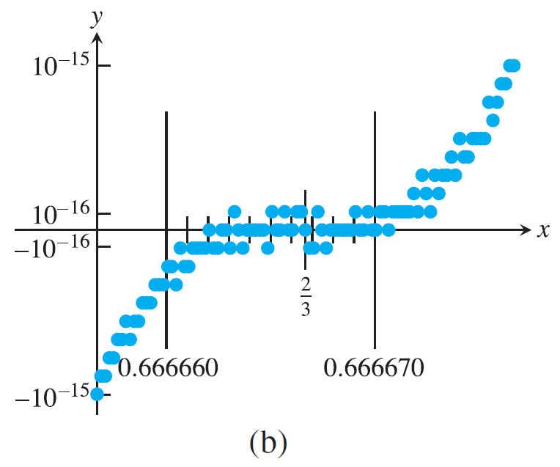
Let’s look at an example
Let’s look at a multiple root.
The backward error is ${\sim 10}^{−16}$.
The computer can calculate the function very close to 0.
The forward error is ${\sim 10}^{−5}$.
There are many $x^{′}s$ that evaluate to machine 0.
The computer sees all of these as being potential answers.
This is a general feature of multiple roots.
Sauer

Slide 23
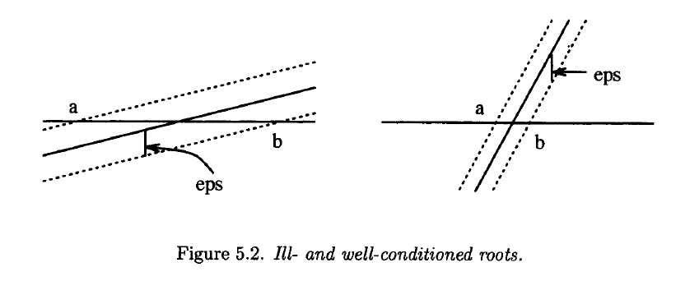
The Condition Number
This is an example of a larger topic in mathematics, the Condition Number.
The condition number is a measure of how “ill-posed” a problem is.
That is, how sensitive is the problem to changes in the input.
For root finding, the condition number is,
$\frac{1}{\left|f^{′}(x_{r})\right| }$
When the slope is small, the problem is
ill-conditioned.
Small changes to the input can cause
large errors.
Hoffman

Slide 24
The Condition Number Contd
The condition number is inherent to a given problem.
A large condition number means that any small perturbation of your input can cause large errors on your output.
This will come up again and again.
You often hear this discussed in reference to the condition number of a matrix.
We’ll get to that!
We need to keep in mind for now that sometimes a good solution can NOT be found through no fault of our own.

Slide 25
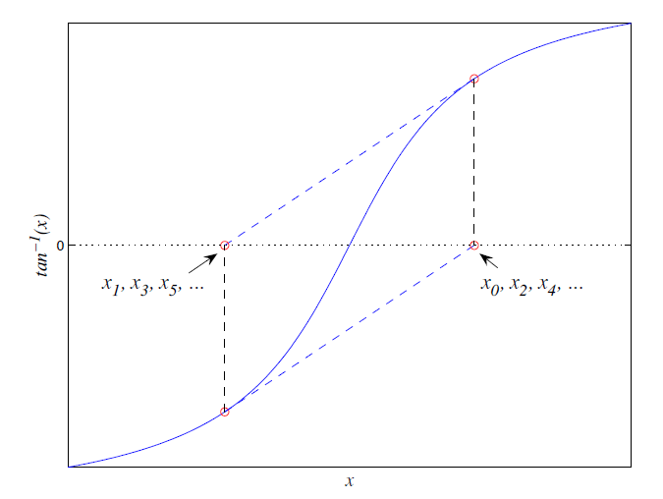
Other ways Newton’s Method can fail
There are times when Newton’s Method fails to converge.
For example, Newton’s Method can get stuck in a loop.
Here is Newton’s Method for $\arctan\left(x\right)$.
If we initialize at a fixed point, we enter a loop.
This will never converge!
Levy

Slide 26
Even more ways it can fail
If the derivative goes to 0 at any point, it fails.
If the derivative at the root does not exist, it fails.
If the derivative is discontinuous, it fails.
There are examples where Newton’s Method diverges to infinity.
Well, really overflows, not infinity.

Slide 27
Issues with the derivative
Newton’s Method is typical very fast and reliable.
Fast in that it requires few steps to converge.
However, this comes at the price of needing to calculate the derivative of the function at every step.
Sometimes calculating the derivative is very time consuming.
Not all derivatives have easily obtained analytic derivatives.
Sometimes we don’t even have a derivative to work with!
Sometimes we don’t have an explicit function but rather a series of data points.
To assuage these issues, we sometimes use an approximation of the derivative.

Slide 28
The Secant Method
The obvious way to approximate the derivative is to use a secant line.
This is just the difference quotient from Calc 1
$f^{′}\left(x\right)≈\frac{f\left(x_{i}\right)−f\left(x_{i−1}\right)}{x_{i}−x_{i−1}}$
To start this method, we need two initial points to form the secant line.
Now, instead of using the tangent line to find an x-intercept, we use the secant line.

Slide 29
The Secant Method Algorithm
We can just replace the derivative in Newton’s Method with the difference quotient
$x_{0}=rand$
$x_{i}=rand$
for i = 1:nstepmax
$x_{i+1}=x_{i}−\frac{f(x_{i})(x_{i}−x_{i−1})}{f\left(x_{i}\right)−f(x_{i−1})}$
end

Slide 30
The Secant Method Error
Assuming the method converges and that the derivative at the root is nonzero and that the root is simple, the error at every iteration is approximated by,
$e_{i+1}≈\left|\frac{f^{′′}(x_{r})}{2f^{′}(x_{r})}\right|e_{i}e_{i−1}$.
IT can further be shown that the error is approximated by
$e_{i+1}≈{\left|\frac{f^{′′}(x_{r})}{2f^{′}(x_{r})}\right|}^{φ−1}e_{i}^{φ}$.
Here, $φ=\frac{1+\sqrt{5}}{2} ≈1.62$.
The golden ratio!
This order of convergence is between linear and quadratic.
We call it superlinear.

